Slide 1
Modeling acoustic scattering by various geometries
Vaibhav Chhaya

Slide 2
Project goals
Develop a modeling framework to compute the target strength and other acoustic scattering metrics from discrete biological structures.
1) Validate finite-element modeling protocol against analytical scattering benchmarks.
2) Apply the validated protocol to CT-derived models of fish.

Slide 3

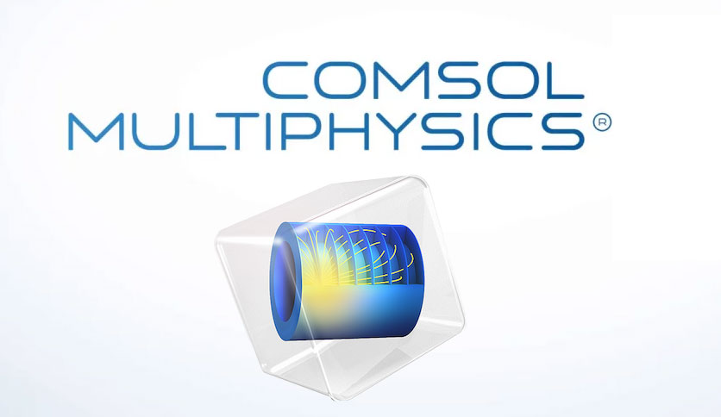
Benchmarking models
vs
Chu’s analytical models for discrete scatterers
Partial wave expansion
COMSOL Multiphysics numerical models
Finite element analysis

Slide 4
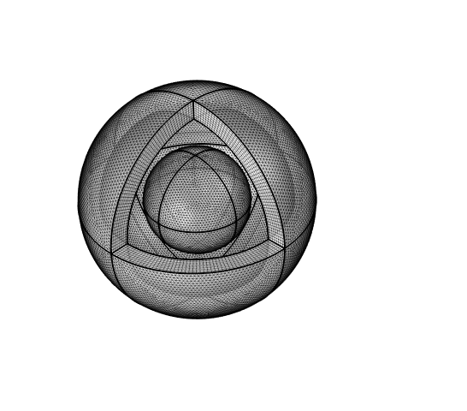
Types of sphere scattering models
Rigid sphere
Bone sphere
Soft sphere
PML
Bone shell with air cavity
Air Bubble
Scatterer
Water domain

Slide 5
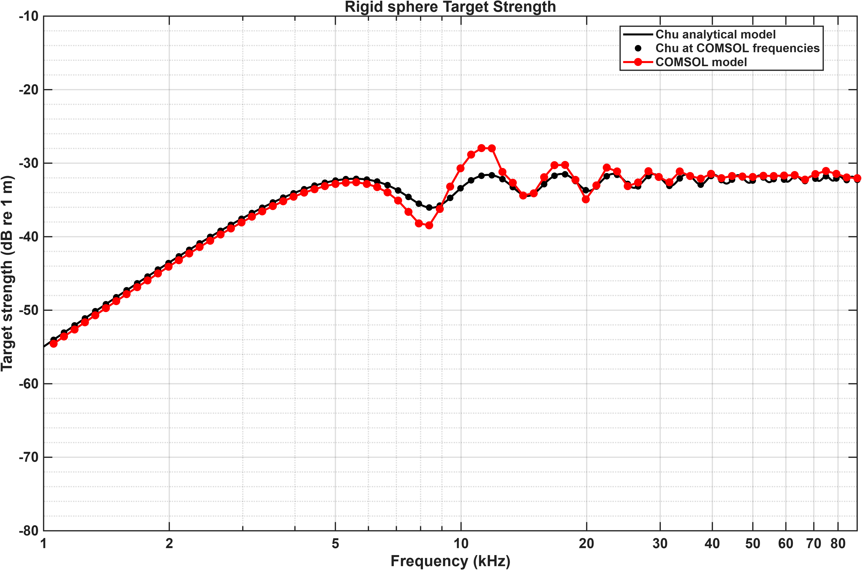
Rigid sphere

Slide 6
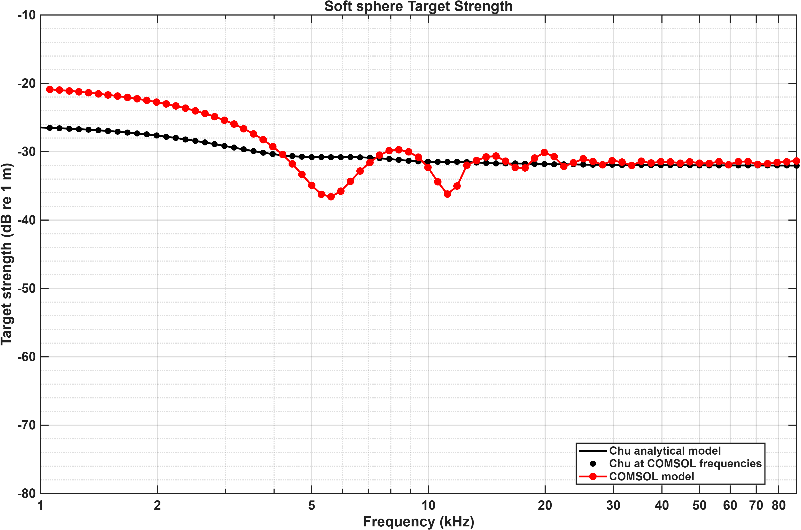
Soft sphere

Slide 7
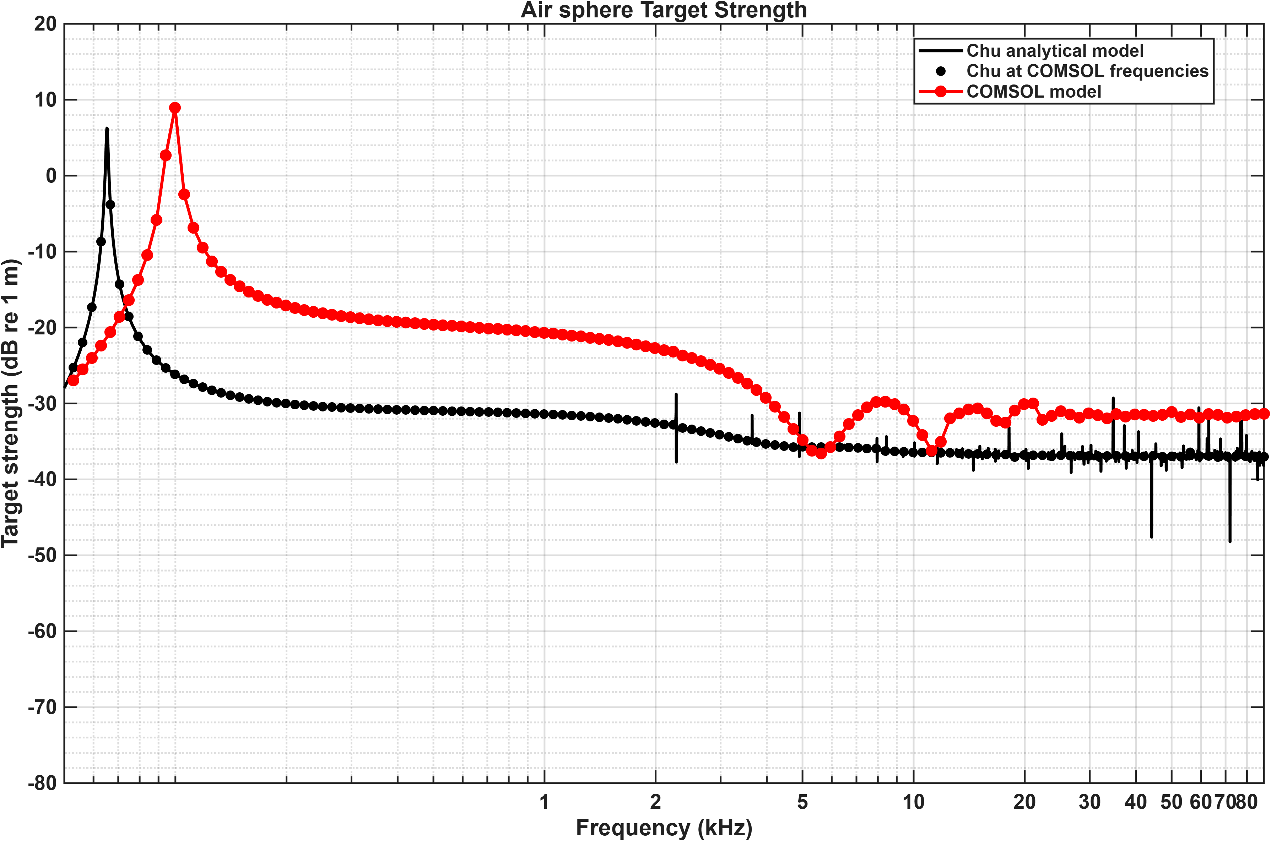
Air Bubble

Slide 8
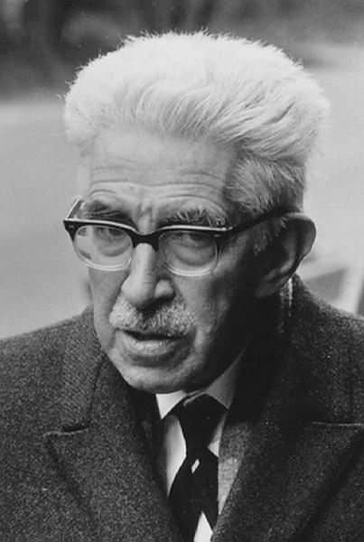
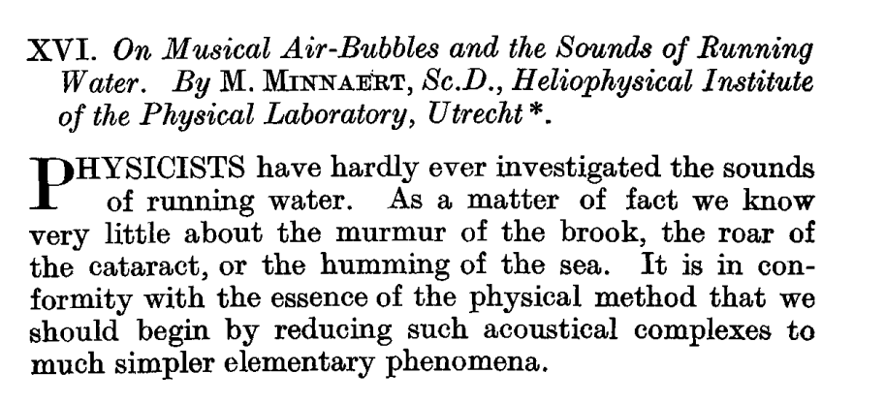

Air Bubble: Minnaert Resonance

Slide 9
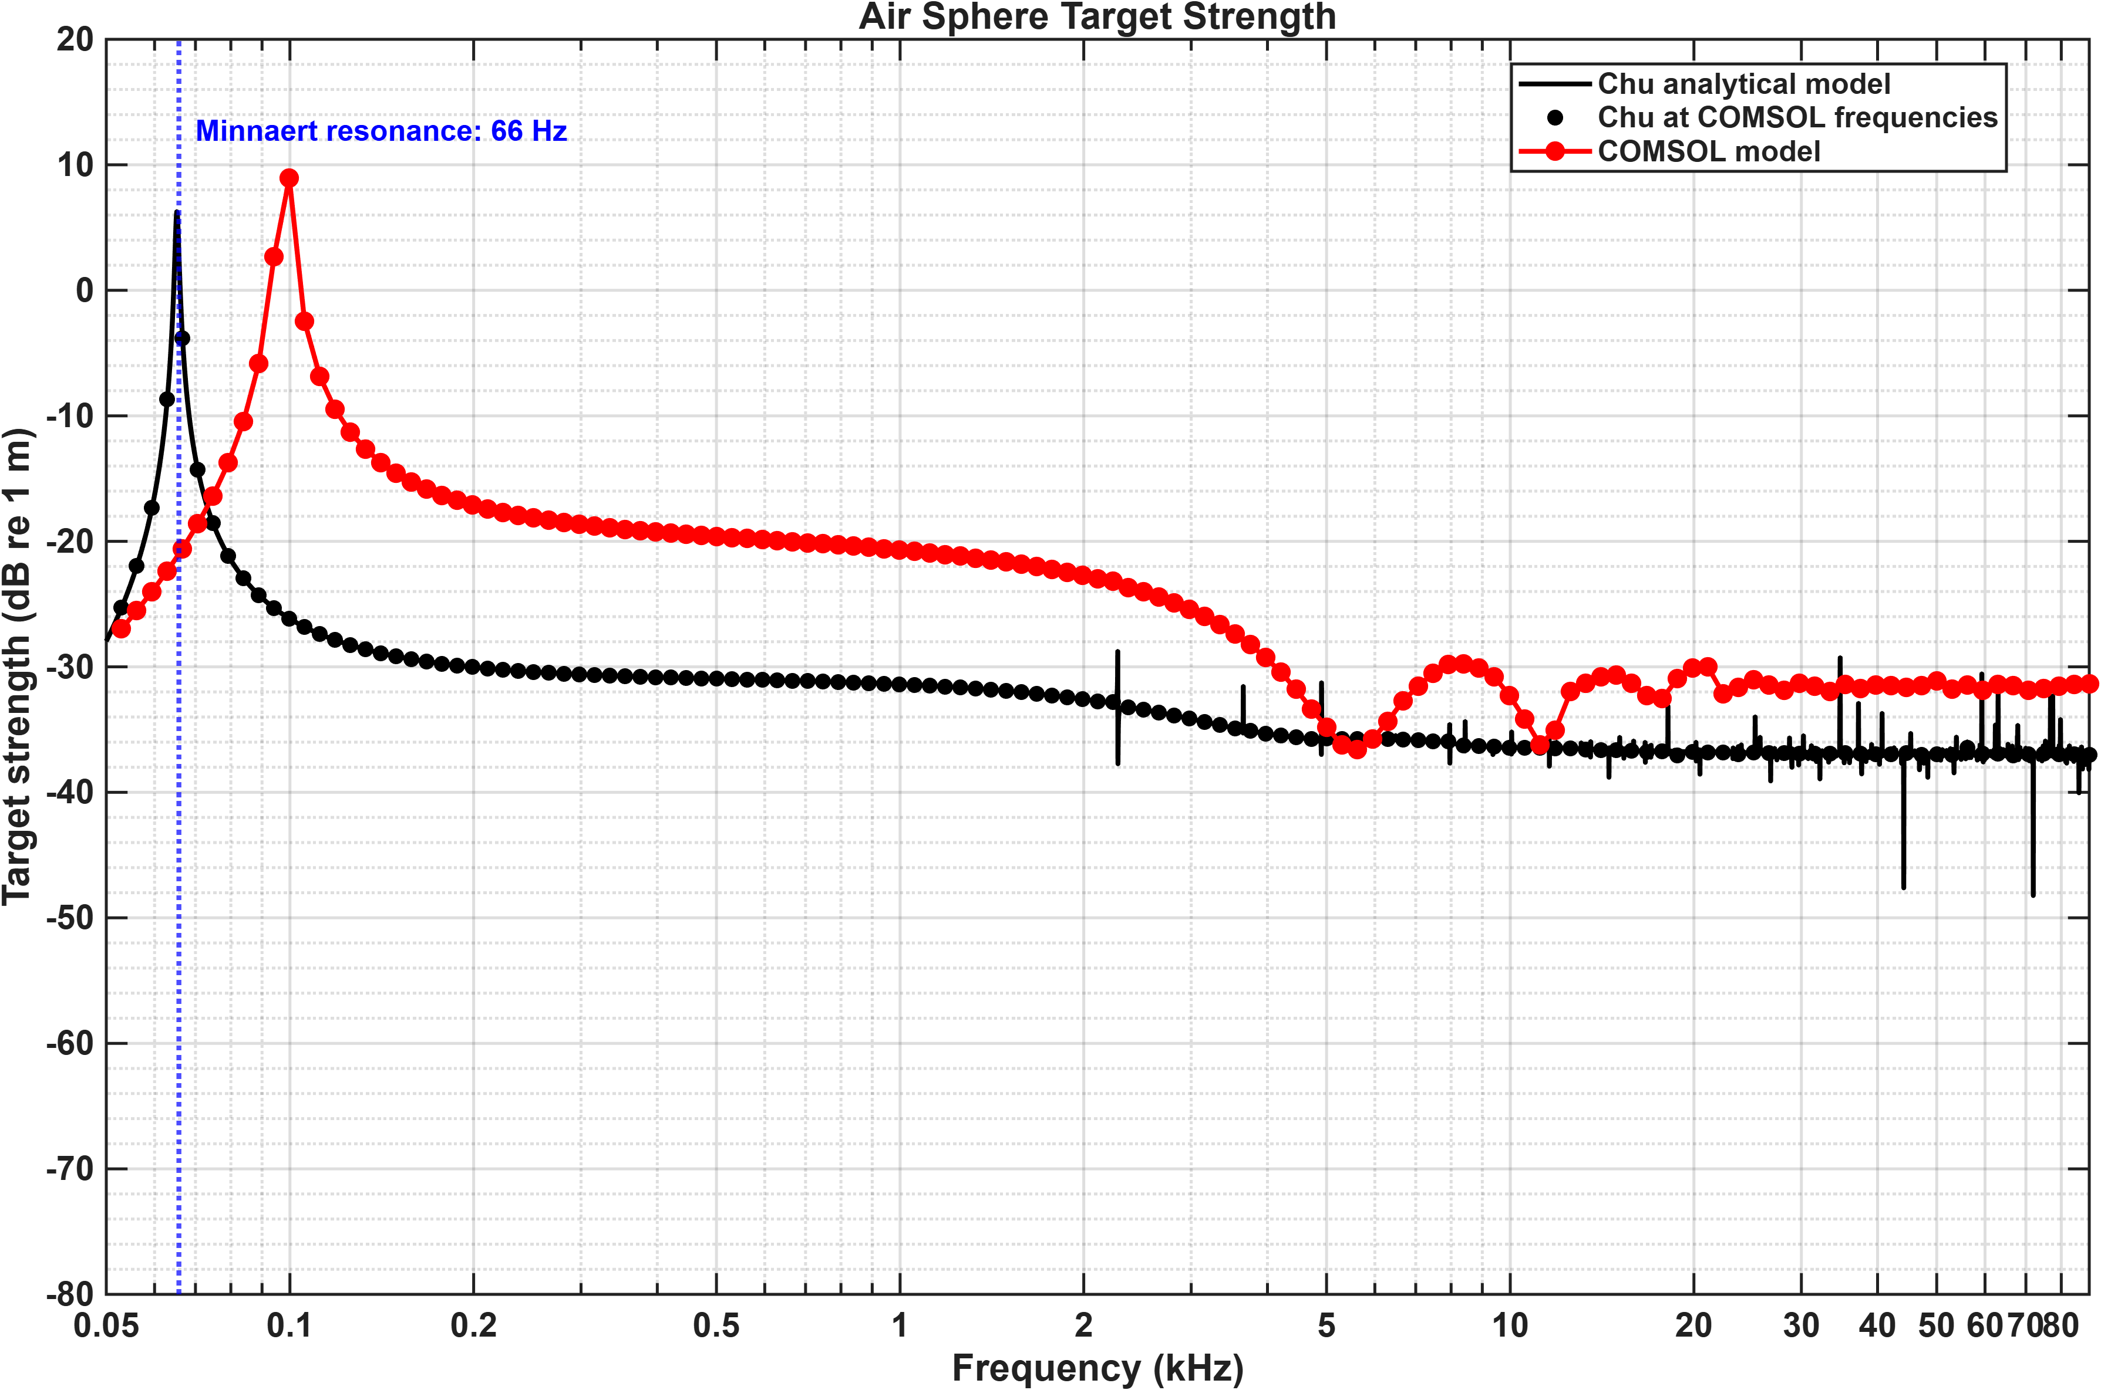
Air Bubble

Slide 10
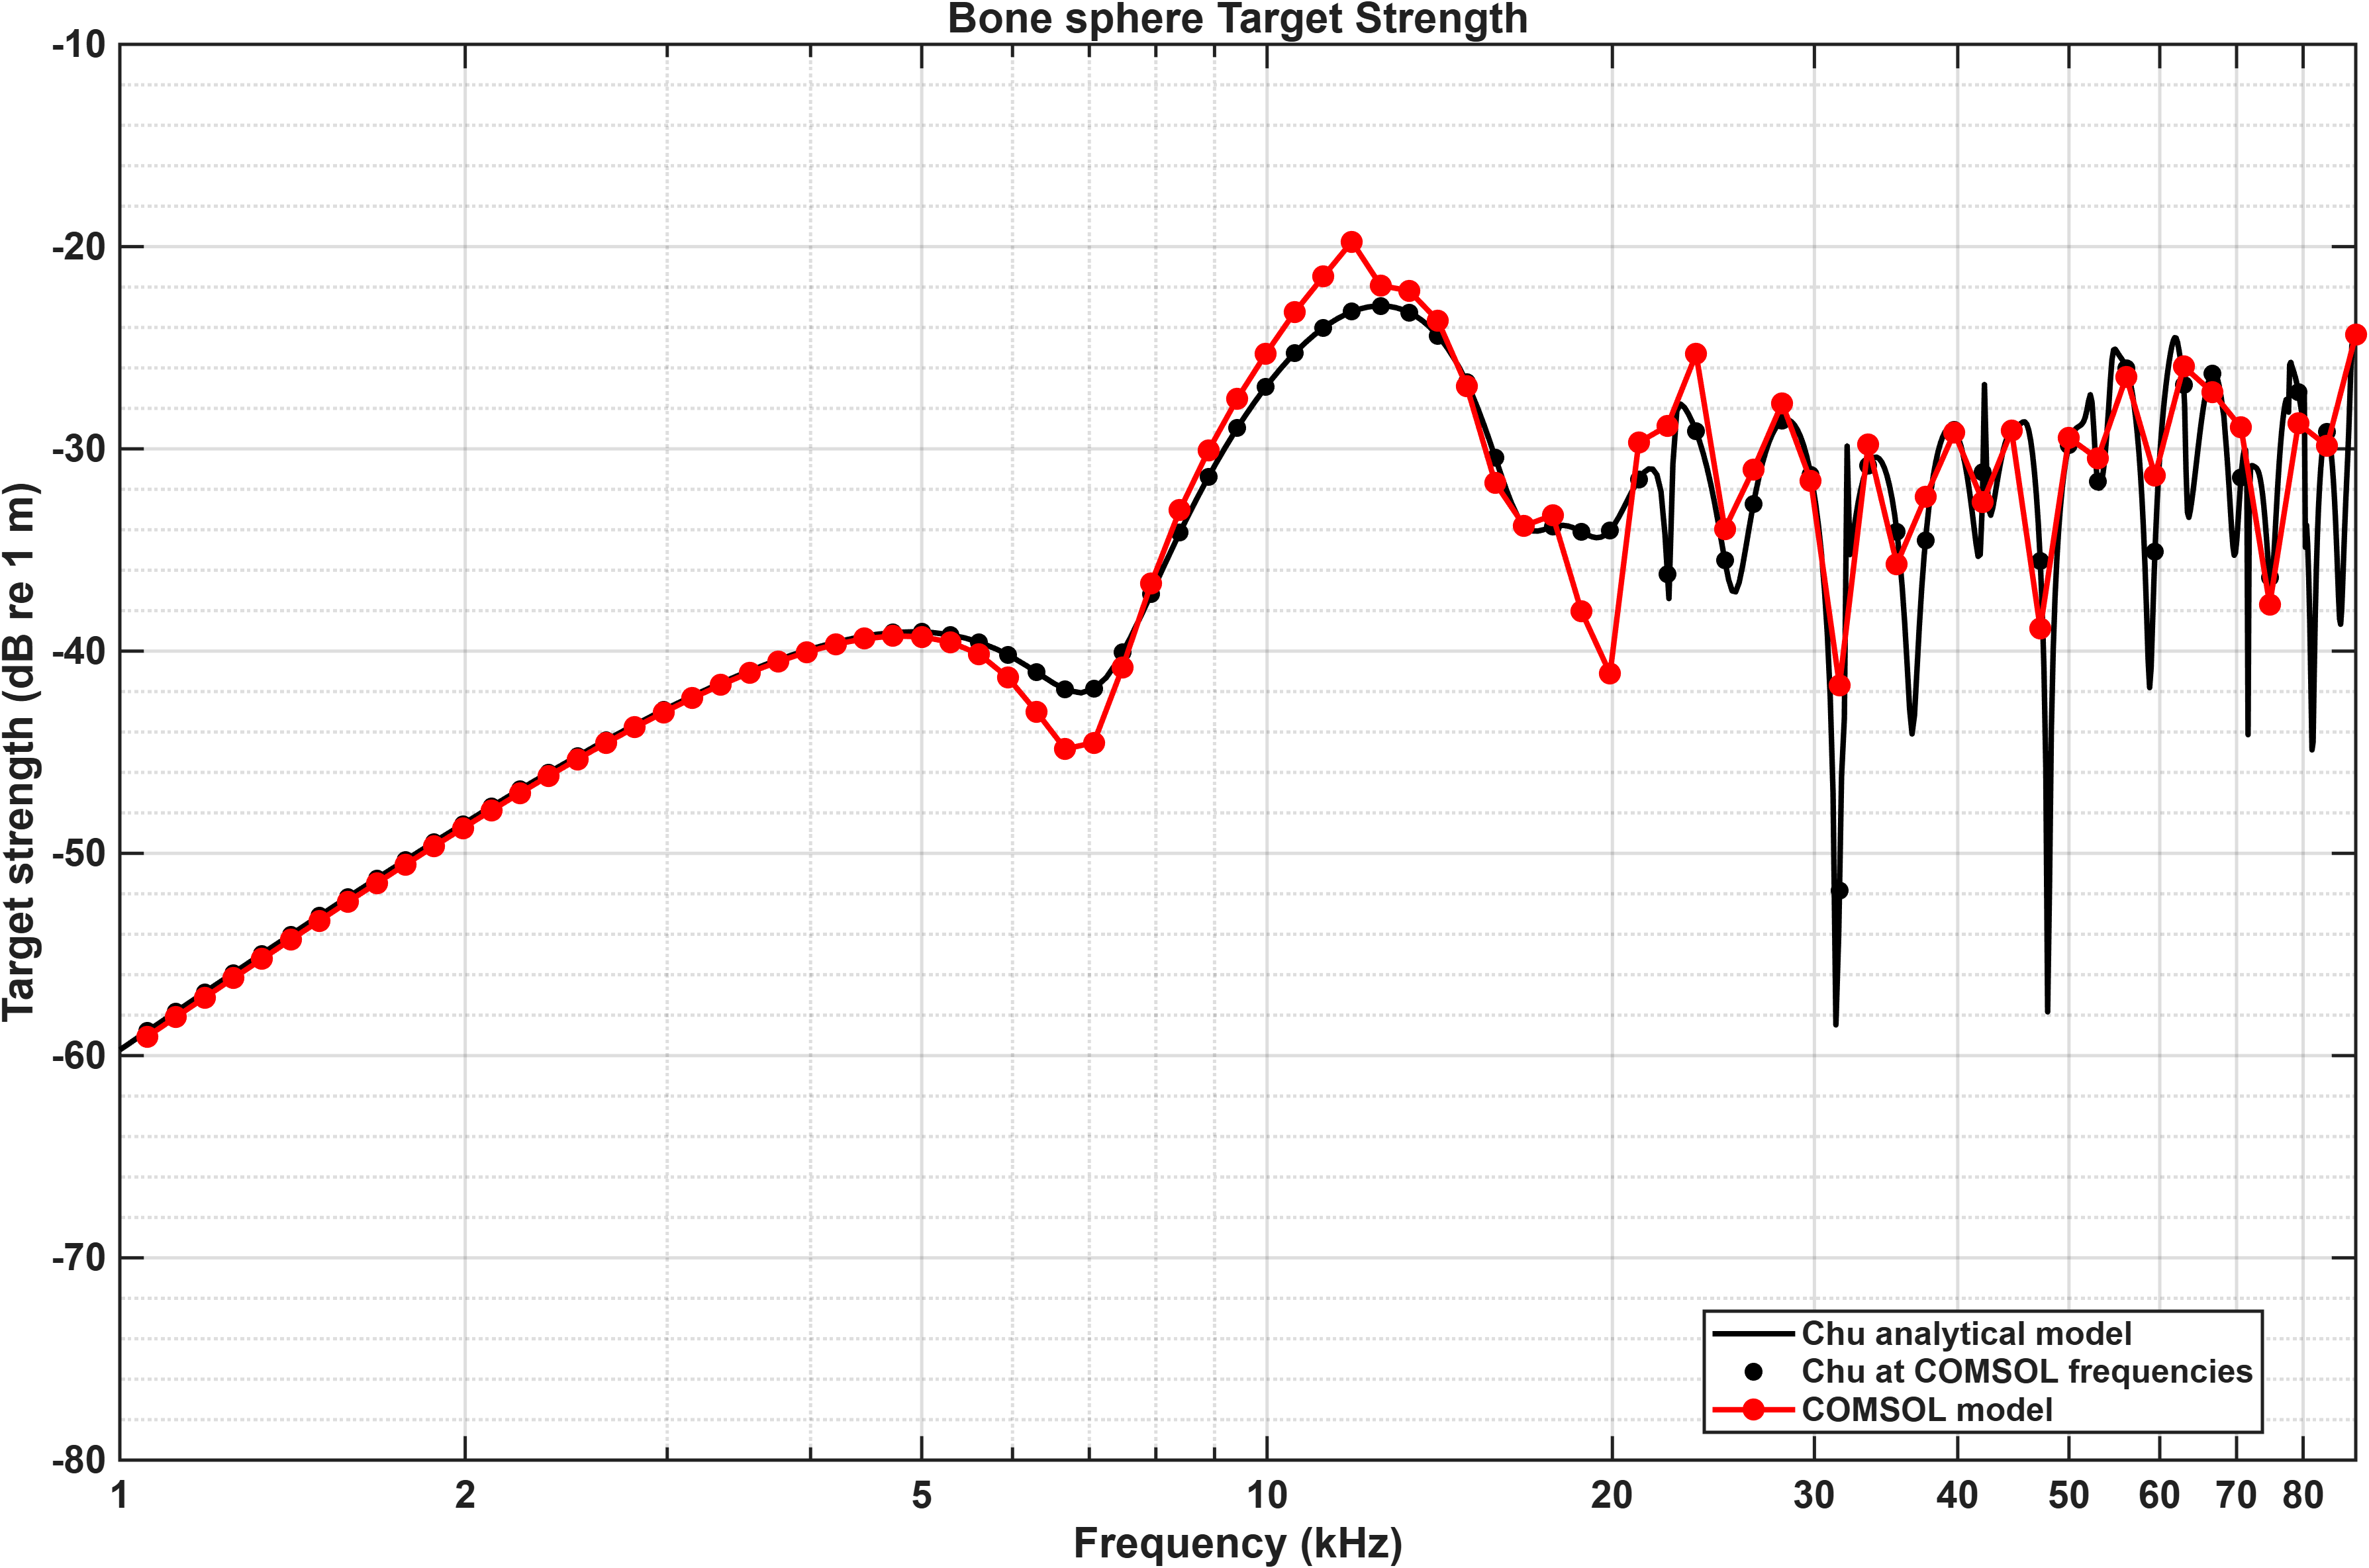
Bone sphere

Slide 11
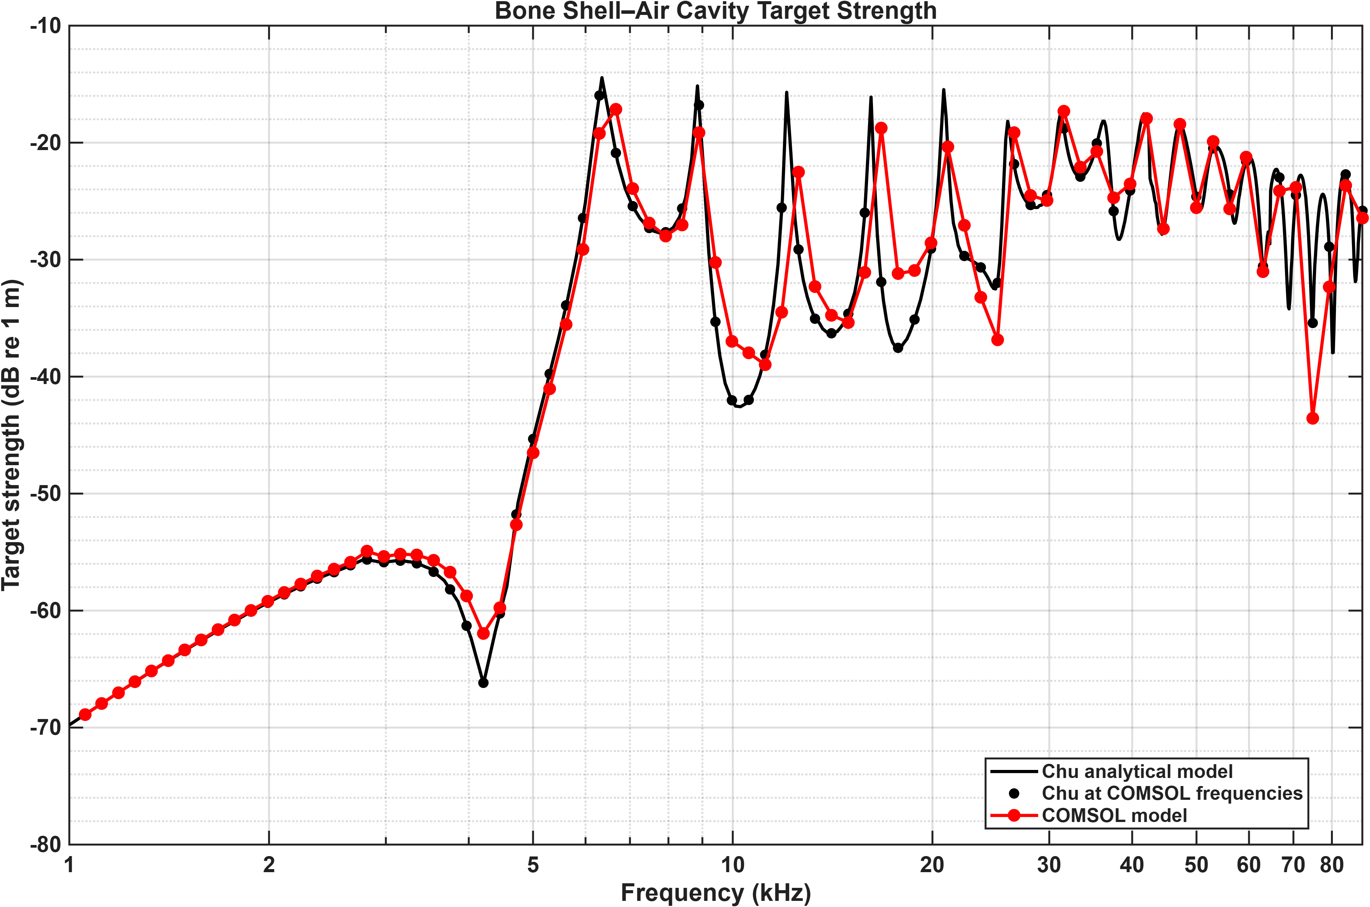
Bone shell with air cavity

Slide 12
Why this mismatch?
PML thickness or scaling method
Inadequate mesh density of scatterer/water domain
Size of the water domain
Some stupid mistake

Slide 13
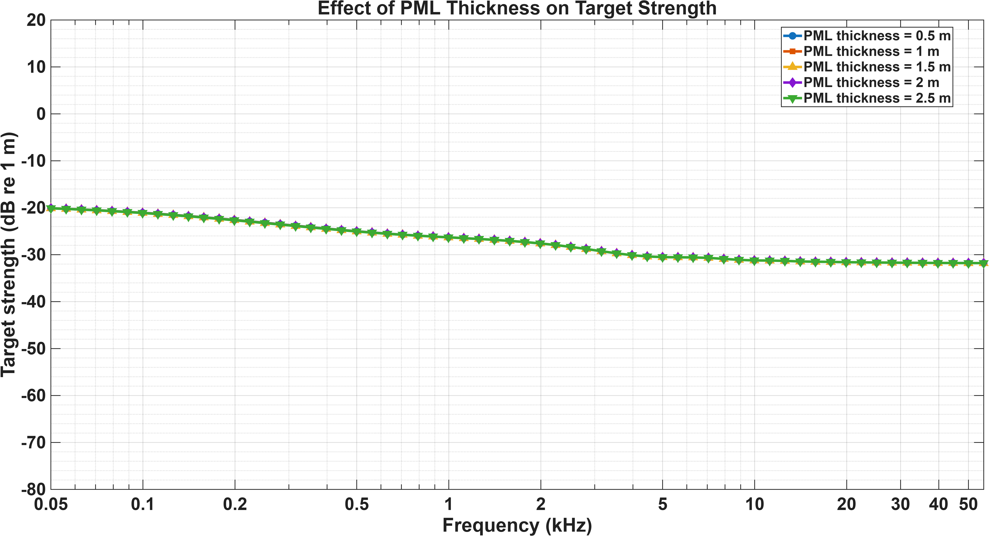
Influence of PML thickness

Slide 14
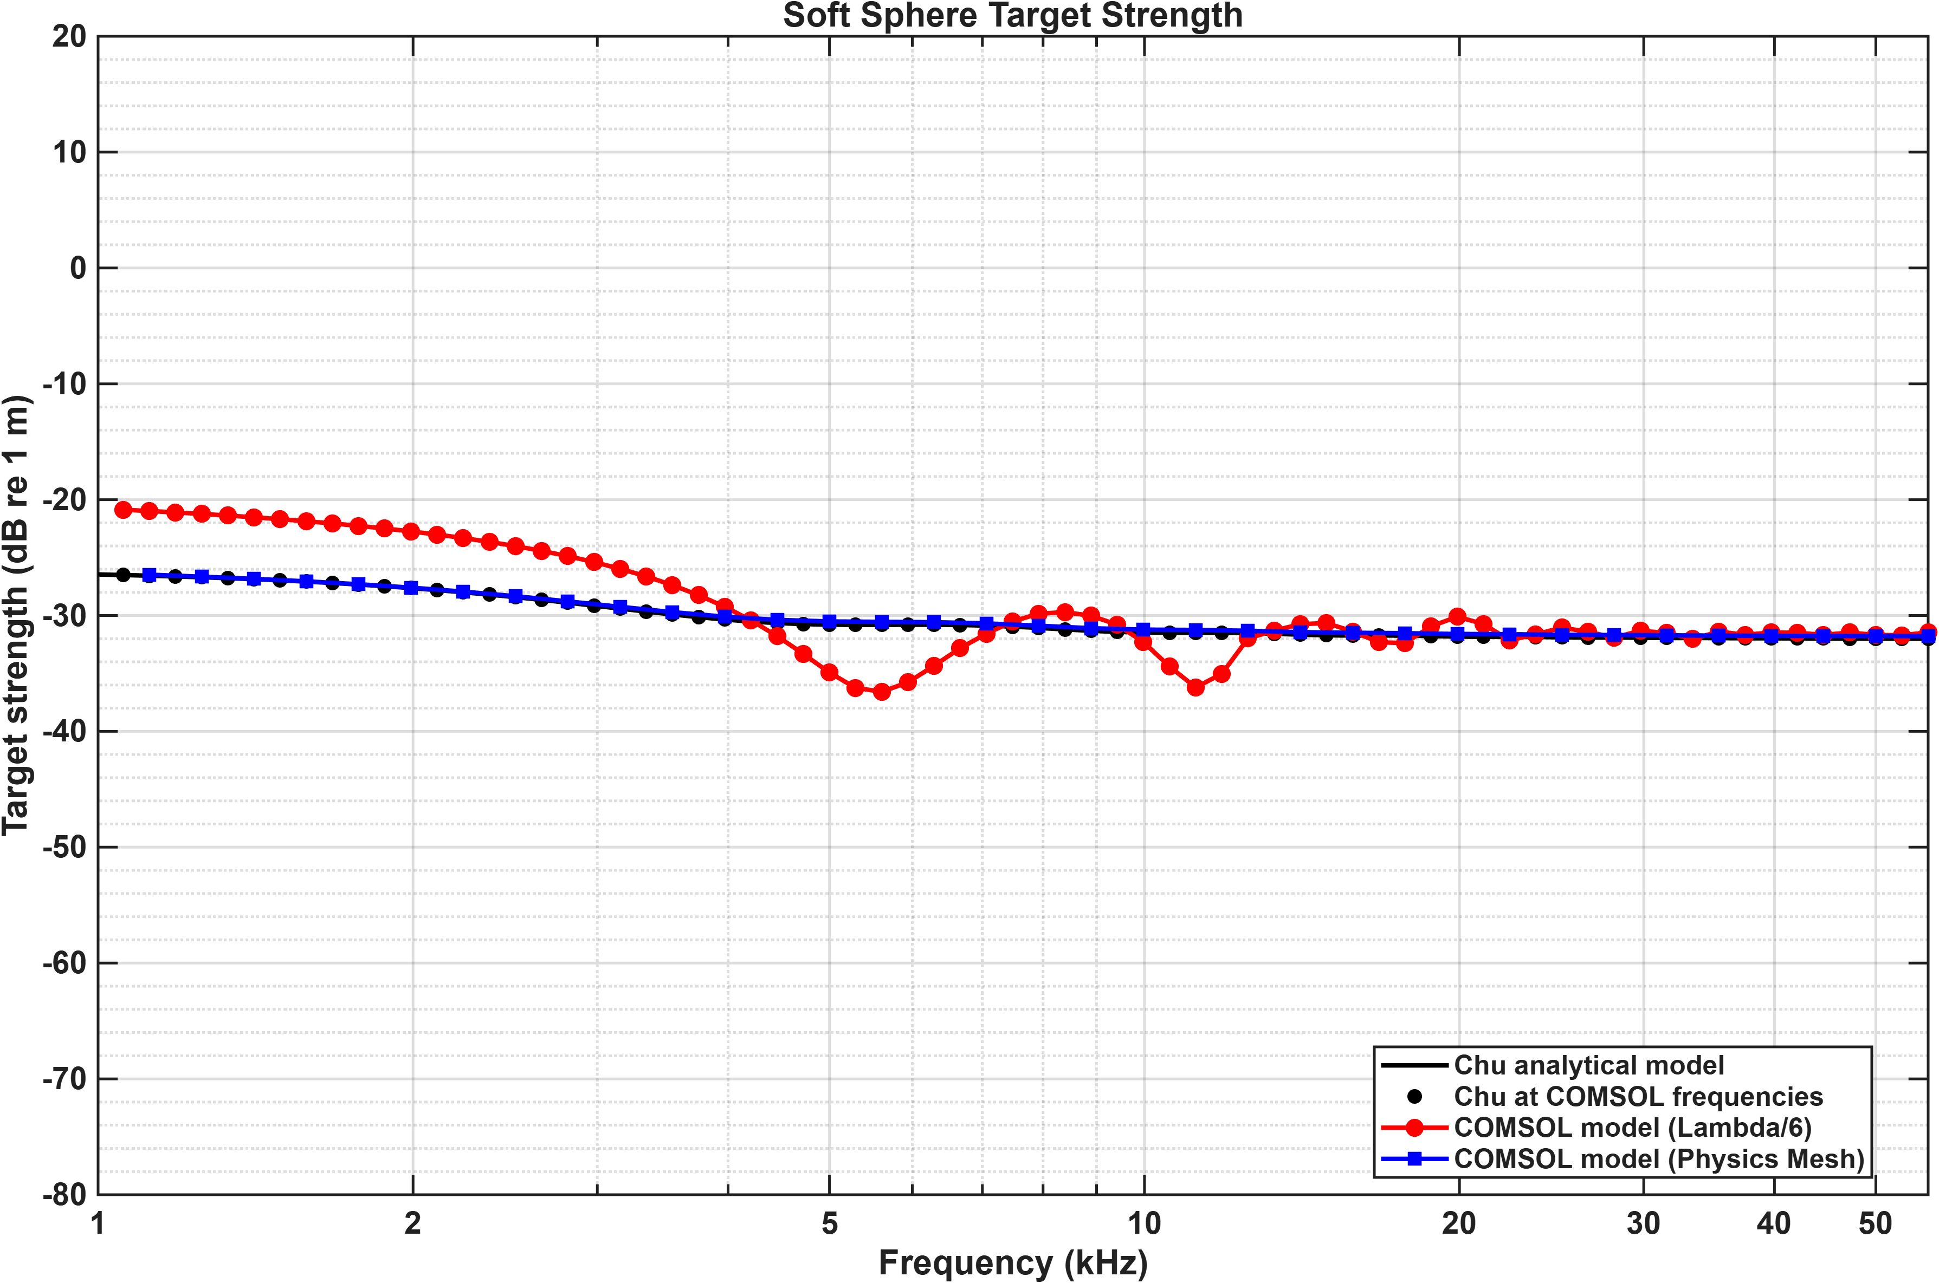
A discovery: physics-based mesh resolves inaccuracies in soft sphere model

Slide 15
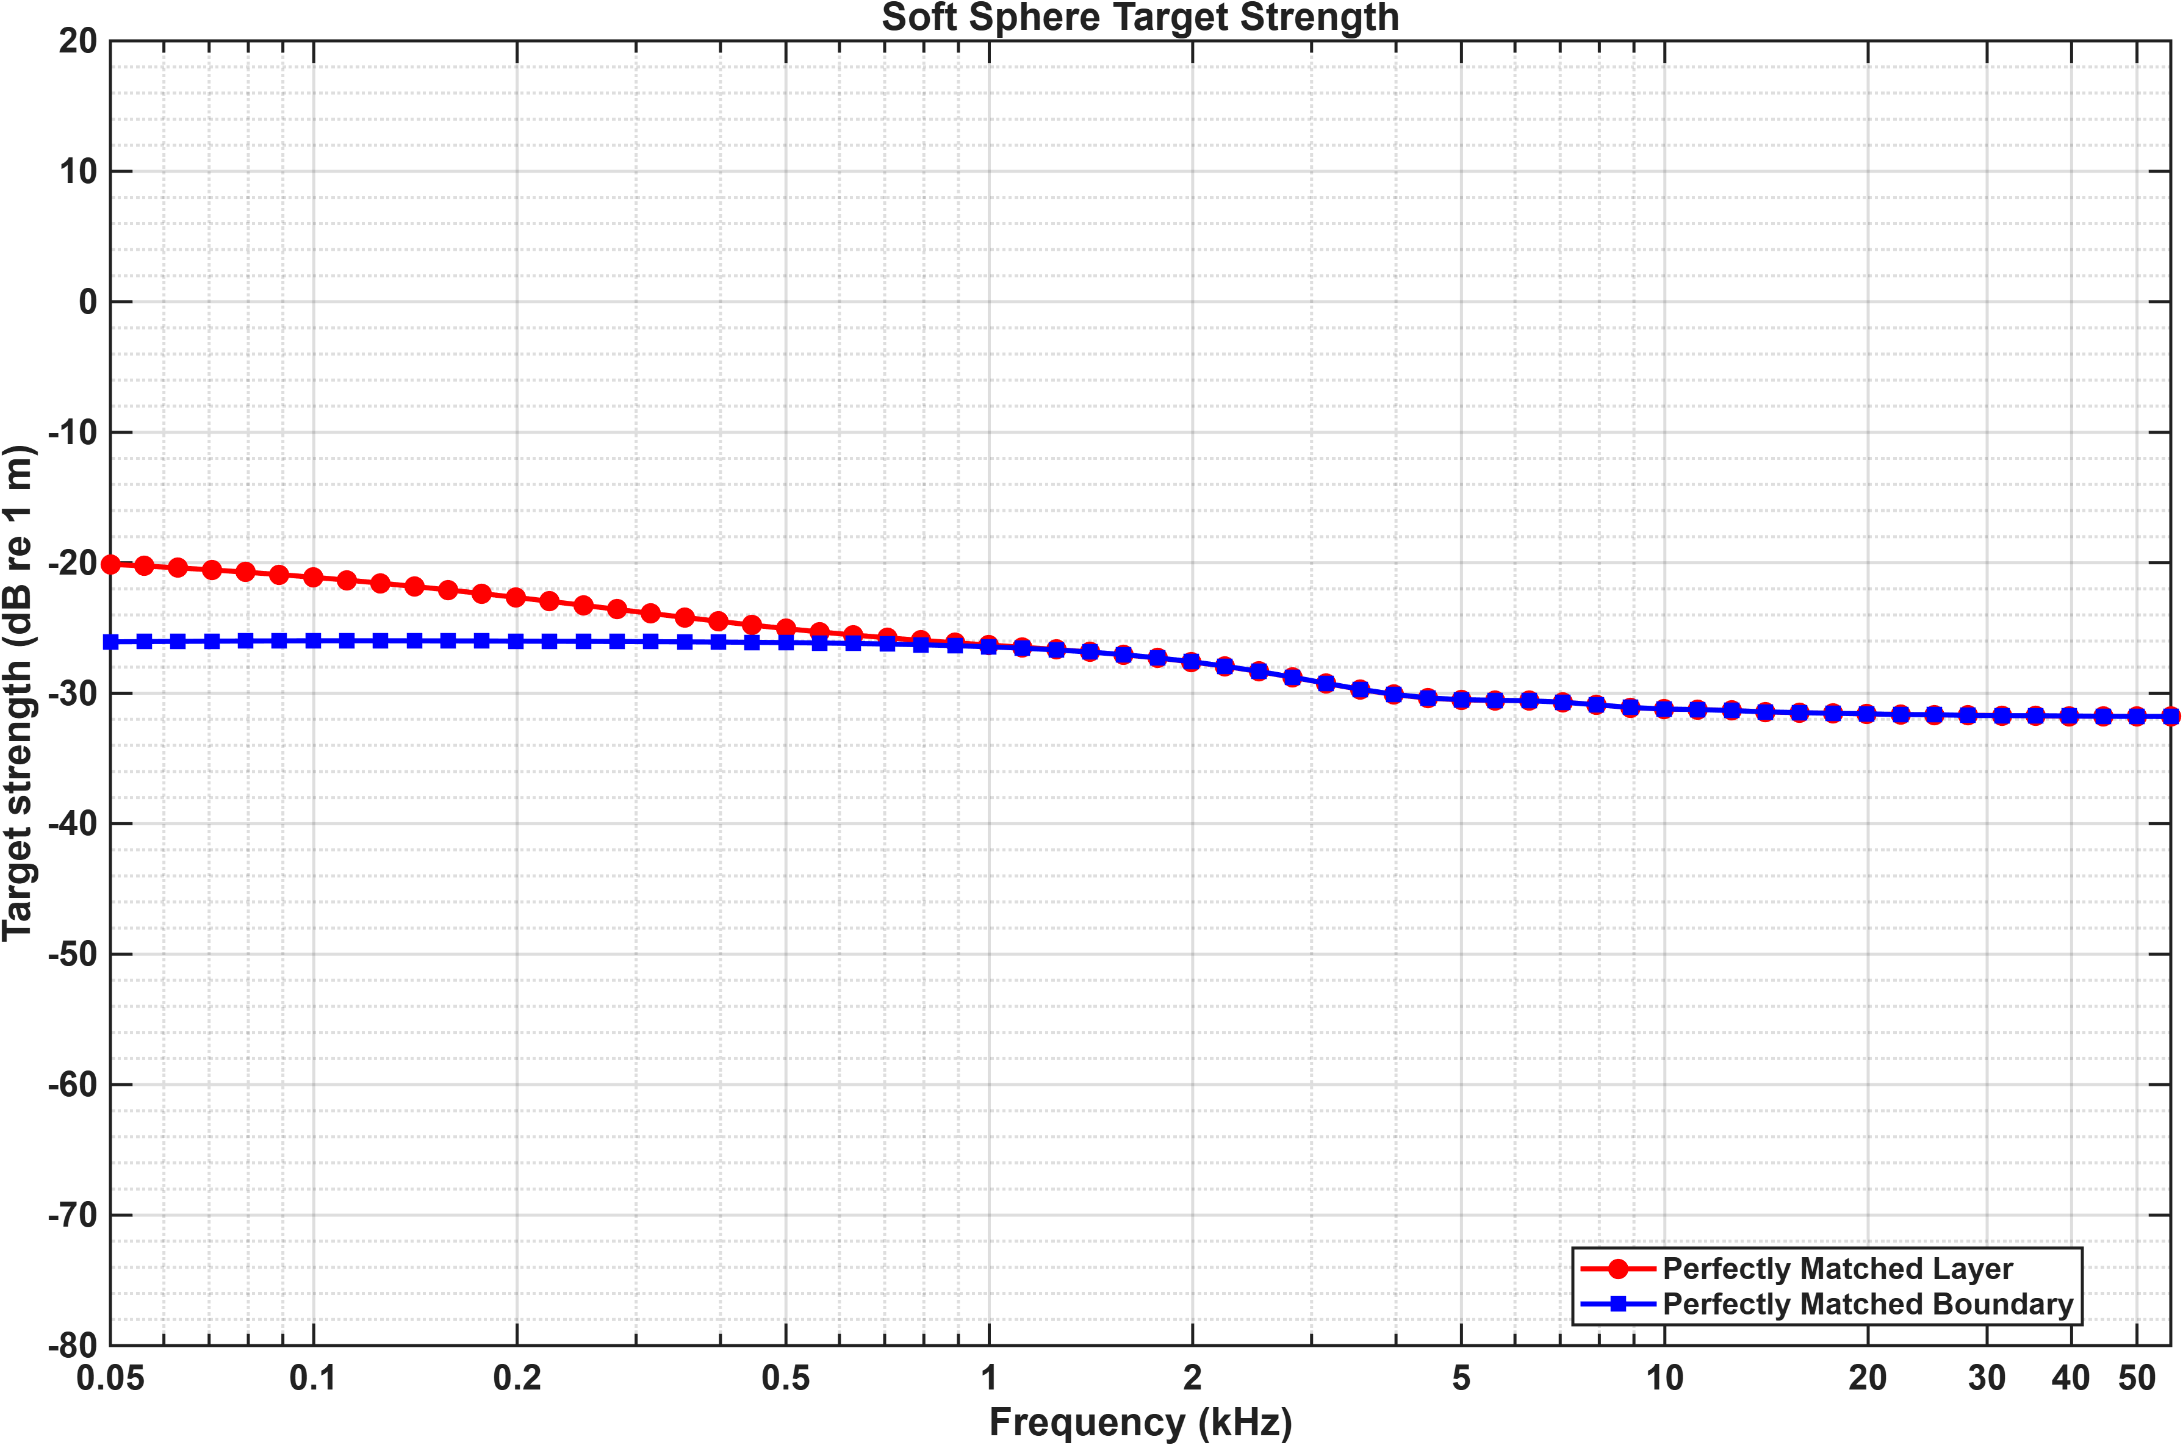
PM Layer vs PM Boundary

Slide 16
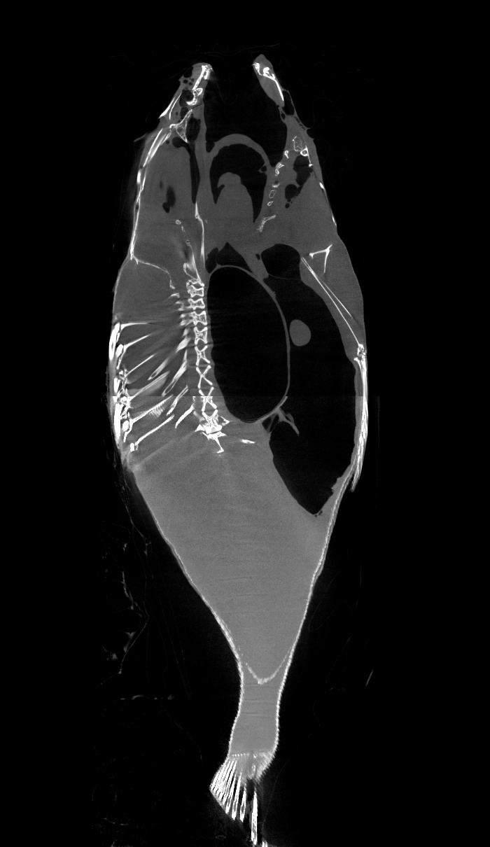
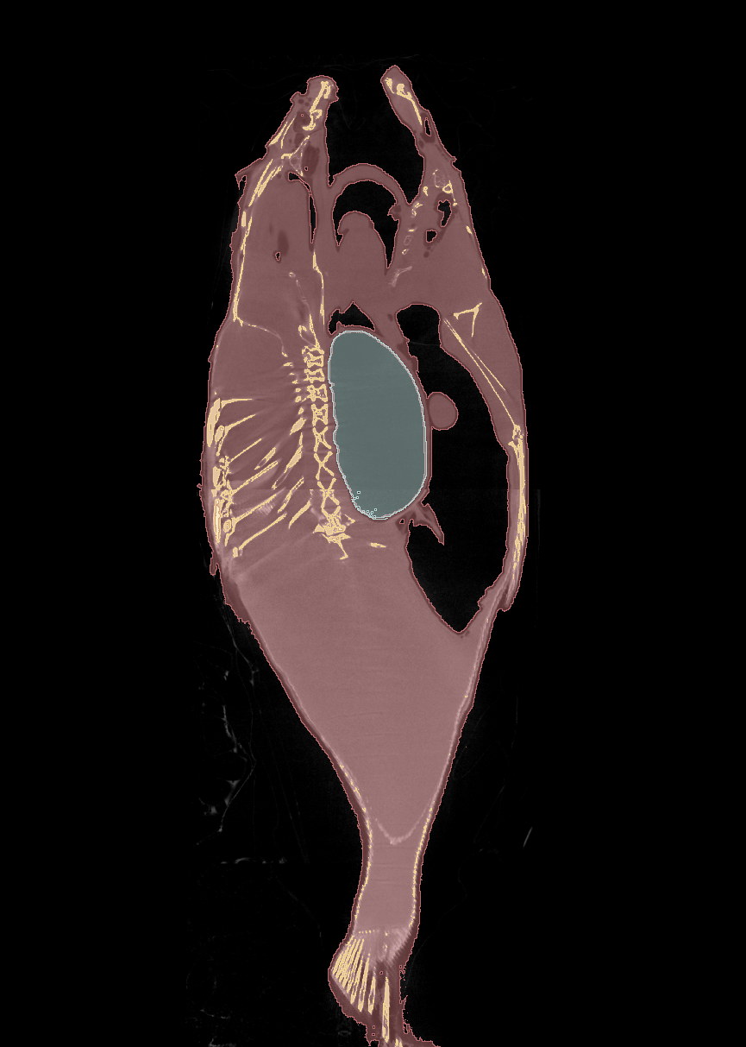
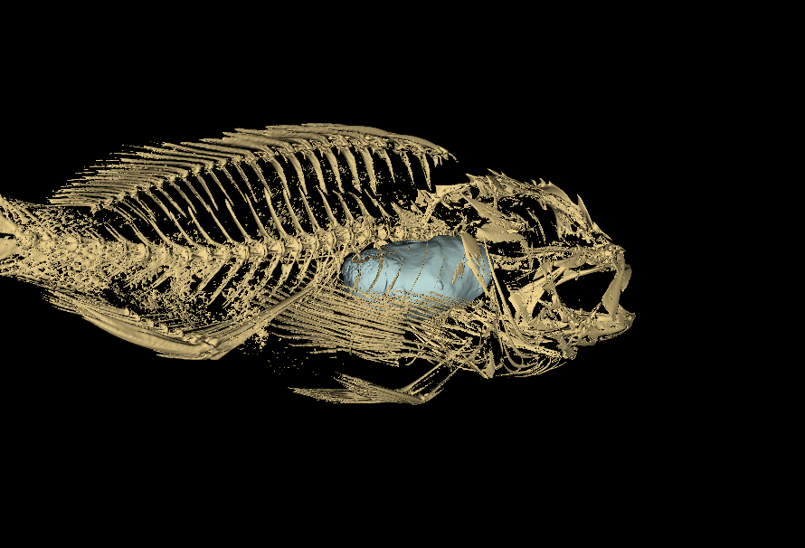
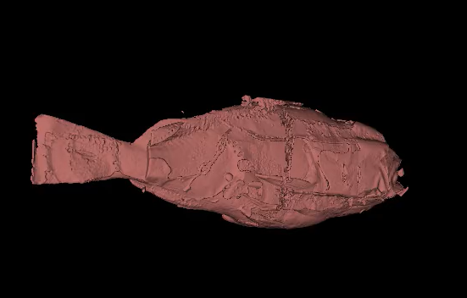
Some preliminary experiments with CT data

Slide 17
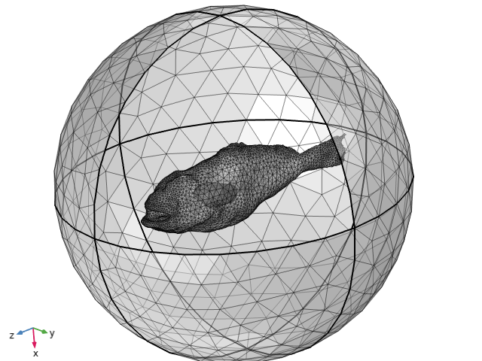
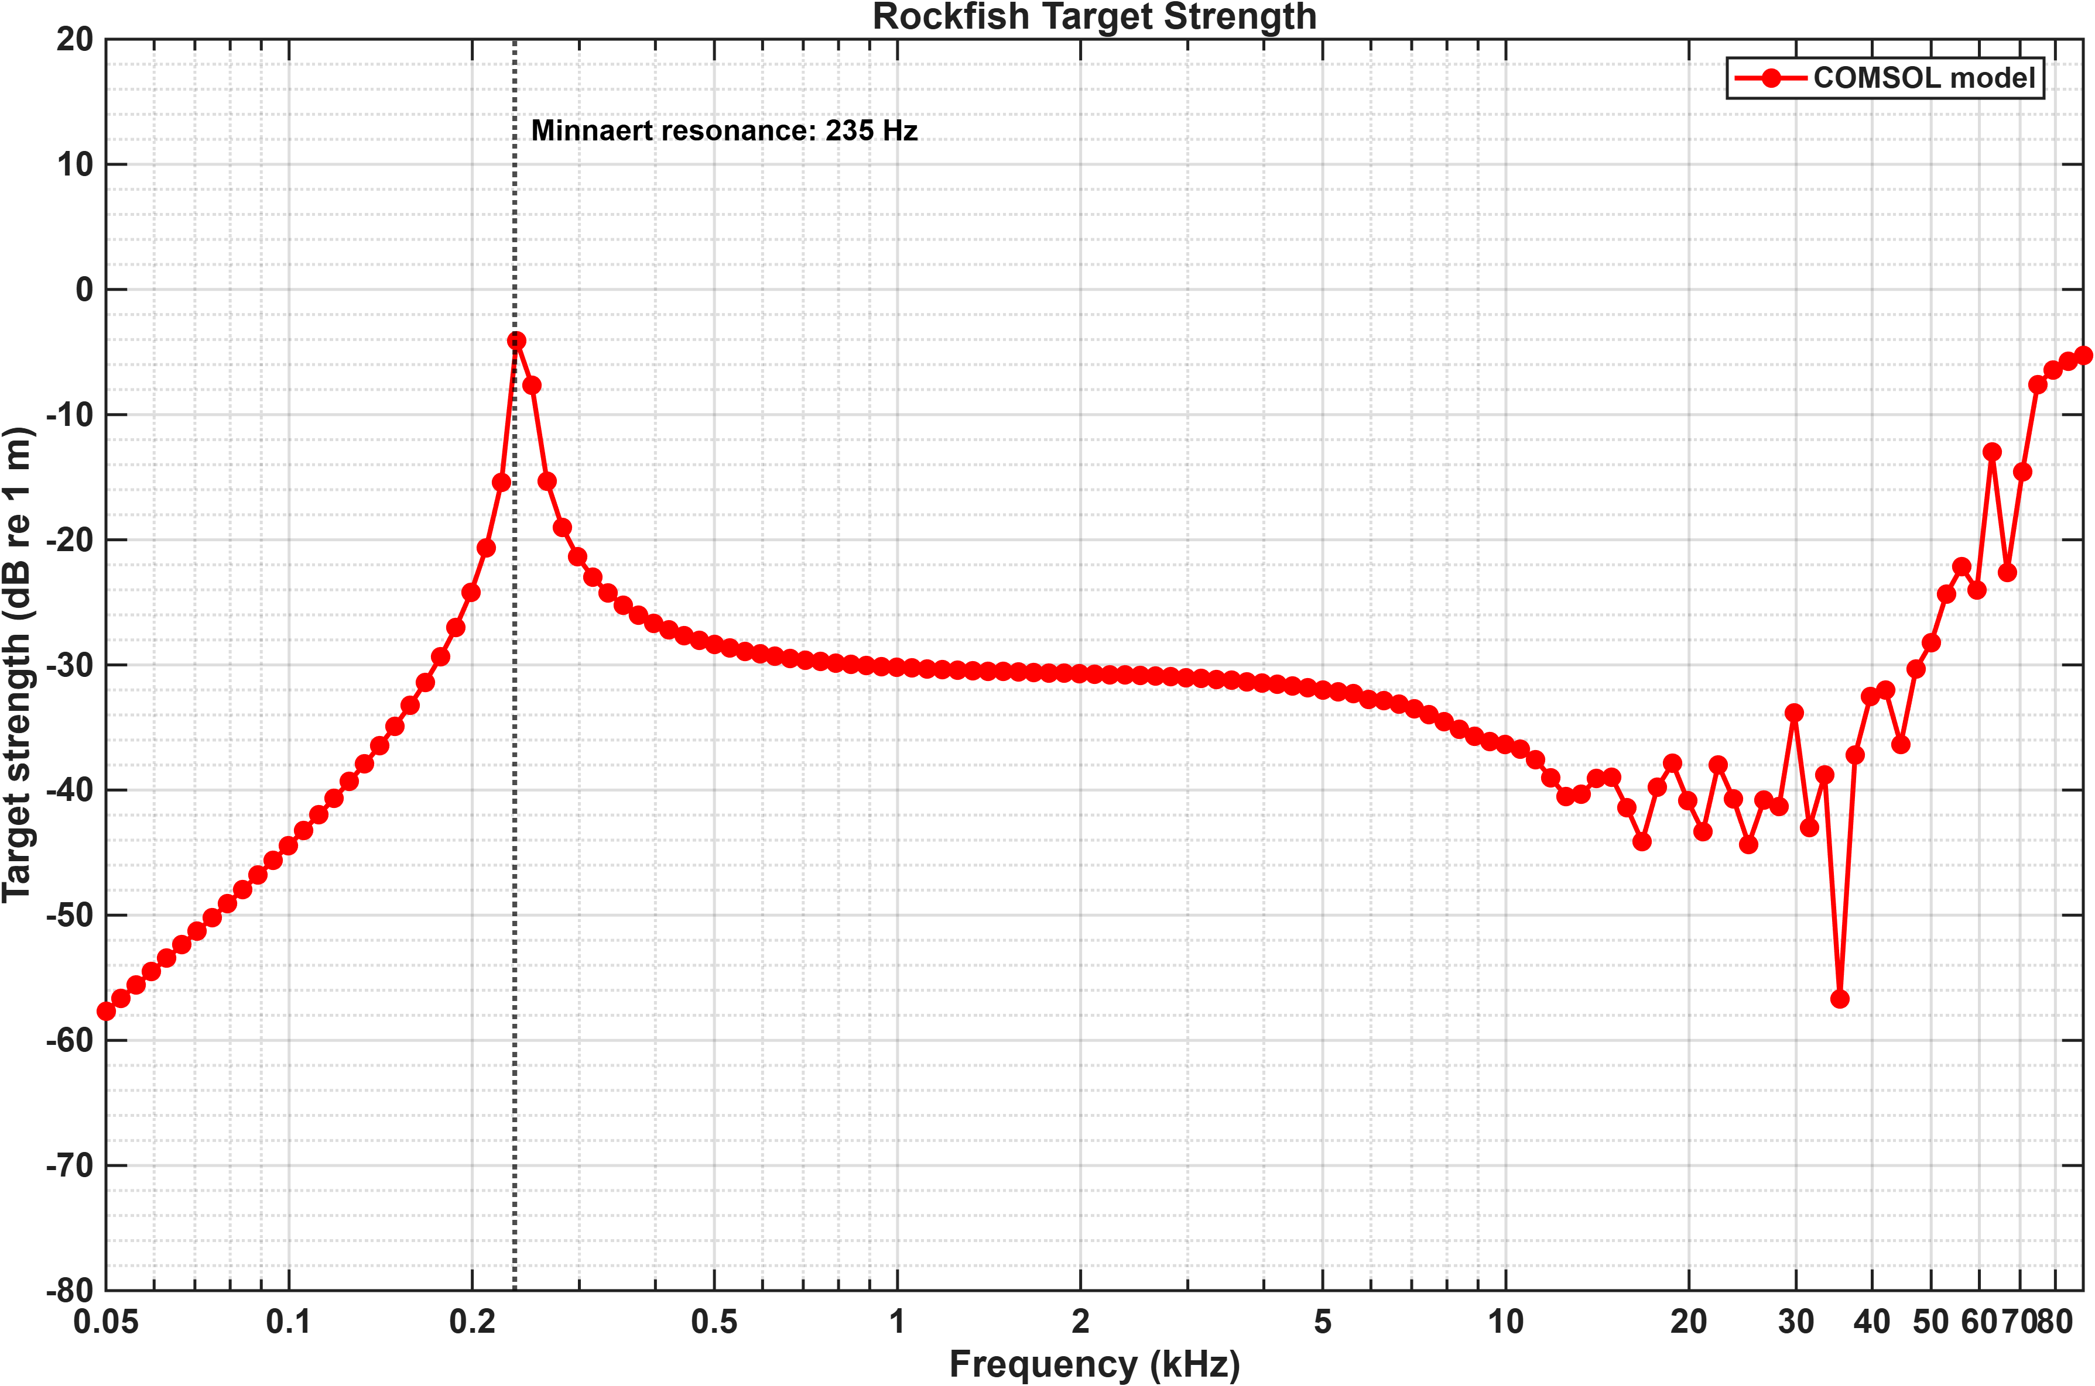
Rockfish scattering function
Using perfectly matched boundary (PMB)
No bony parts assigned yet
Volume equivalent radius of SB: 14 mm

Slide 18
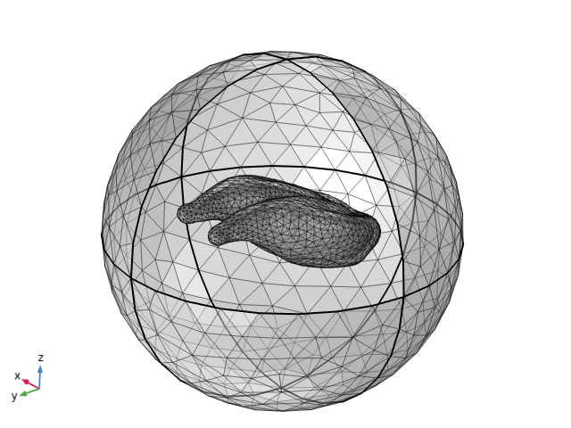
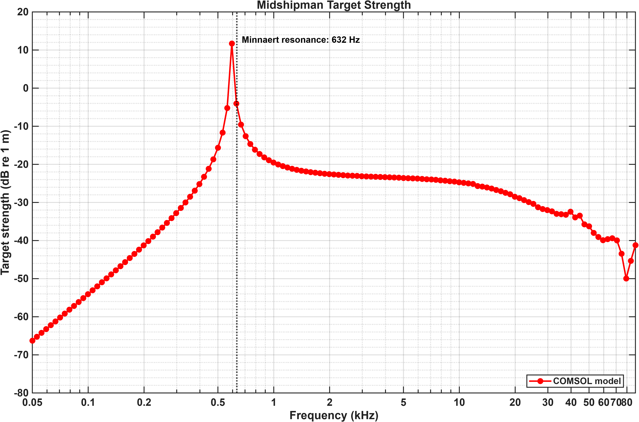
Plainfin midshipman scattering function
Using perfectly matched boundary (PMB)
Only swim bladder geometry included
Volume equivalent radius of SB: 5.2 mm

Slide 19
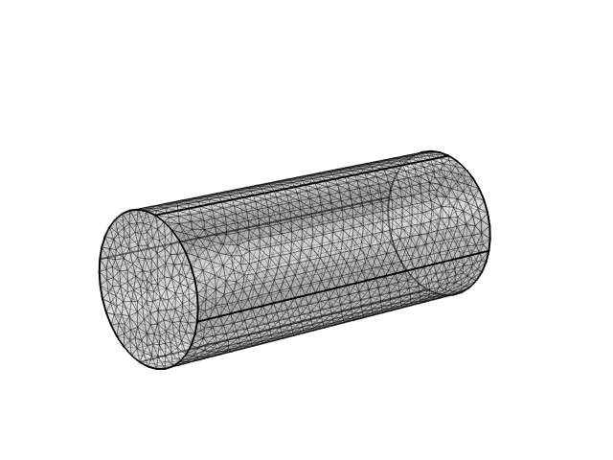
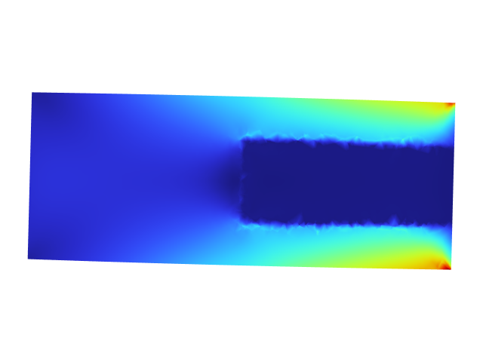
In progress: Voxel-based material property assignment

Slide 20
Future directions
Benchmarking
Run all models with physics-based mesh to check if mismatches are resolved. Examine the differences in mesh sizes between user-specified and physics-based method
Sanity check with YoonJeon’s elastic sphere model
CT models
Run more expensive PML based models with rockfish and midshipman
Develop a method for voxel-based assignment of bone properties

